Slide 1
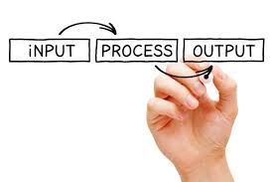
Presentation On IPO in Computer
Presented By:-
Ankit Yadav
O-Level
Under Guidance:-
Ashish Sir

Slide 2
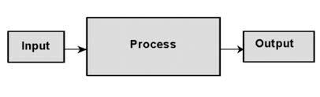
Presentation On IPO
What is IPO
IPO is stand for Input Process Output also known as IPO Cycle
The IPO cycle is defined as a computer procedure for the processing of information. In computation, it is a critical process through which users get the desired outcome. It comprises mainly of three elements; input, process, and output.

Slide 3
Input Devices
Keyboard
Mouse
Microphone
Light Pen
Scanner
What is Input Device
Input Device Definition: A piece of equipment/hardware which helps us enter data into a computer is called an input device.

Slide 4

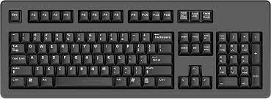
KEYBOARD
Keyboard:-
A Keyboard is for putting information including letters, words and number into your computer

Slide 5

MOUSE
Mouse:-
The mouse is a small, movable device that lets you control a range of things on a computer.

Slide 6

MICROPHONE
MICROPHONE:-
A microphone is a device that translates sound vibrations in the air into electronic signals and scribes them to a recording medium or over a loudspeaker.

